Slide 1


OCP 1Z0-809
Dr.-Ing Mohamed Amine Mezghich
Associate Professor at ENSI, CEO of Smart IT Partner
JAVA/J2EE Certified Trainer
ma.mezghich@smart-it-partner.com
amine.mezghich@ensi-uma.tn

Slide 2

Important information
1-Exam:
https://education.oracle.com/pls/web_prod-plq-dad/db_pages.getpage?page_id=5001&get_params=p_exam_id:1Z0-809
2-Book :
https://ebookbros.com/product/ocp-oracle-certified-professional-java-se-8-programmer-ii-study-guide-exam-1z0-809-1st-edition-pdf-version/
3-Practice Tests :
https://www.wiley.com/en-us/OCA+OCP+Java+SE+8+Programmer+Practice+Tests-p-9781119363361

Slide 3
Outlines
Chapter 1 : Advanced Class Design
Chapter 2 : Design Patterns and Principles
Chapter 3 : Generics and Collections
Chapter 4 : Functional Programming
Chapter 5 : Dates, Strings and Localization
Chapter 6 : Exceptions and Assertions
Chapter 7 : Concurrency
Chapter 8 : IO
Chapter 9 : NIO.2
Chapter 10 : JDBC

Slide 4
Chapter 4 : Functional Programming
The OCP exam topics covered in this chapter include the following: Generics and Collections ■ Collections Streams and Filters ■ Iterate using forEach methods of Streams and List ■ Describe Stream interface and Stream pipeline ■ Use method references with Streams

Slide 5
Chapter 4 : Functional Programming
The OCP exam topics covered in this chapter include the following: Lambda Built-In Functional Interfaces ■ Use the built-in interfaces included in the java.util.function package such as Predicate, Consumer, Function, and Supplier ■ Develop code that uses primitive versions of functional interfaces ■ Develop code that uses binary versions of functional interfaces ■ Develop code that uses the UnaryOperator interface

Slide 6
Chapter 4 : Functional Programming
The OCP exam topics covered in this chapter include the following: Java Stream API ■ Develop code to extract data from an object using peek() and map() methods including primitive versions of the map() method ■ Search for data by using search methods of the Stream classes including findFirst, findAny, anyMatch, allMatch, and noneMatch ■ Develop code that uses the Optional class ■ Develop code that uses Stream data methods and calculation methods ■ Sort a collection using Stream API ■ Save results to a collection using the collect method

Slide 7
Chapter 4 : Functional Programming
By now, you should be comfortable with the lambda and method reference syntax. Both are used when implementing functional interfaces.
In this chapter, we will introduce many more functional interfaces and Optional classes. Then we will introduce the Stream pipeline and tie it all together. You might have noticed that this chapter covers a long list of objectives.

Slide 8
1-Using Variables in Lambdas
Lambda expressions can access static variables, instance variables, effectively final method parameters, and effectively final local variables. How many of those can you find in this example? 1: interface Gorilla { String move(); } 2: class GorillaFamily { 3: String walk = "walk"; 4: void everyonePlay(boolean baby) { 5: String approach = "amble"; 6: //approach = "run"; 7: 8: play(() -> walk); 9: play(() -> baby ? "hitch a ride": "run"); 10: play(() -> approach); 11: }
12: void play(Gorilla g) { 13: System.out.println(g.move()); 14: } 15: }

Slide 9
1-Using Variables in Lambdas
Line 8 uses an instance variable in the lambda. Line 9 uses a method parameter. We know it is effectively final since there are no reassignments to that variable. Line 10 uses an effectively final local variable. If we uncomment line 6, there will be a reassignment and the variable will no longer be effectively final. This would cause a compiler error on line 10 when it tries to access a non–effectively final variable.
The normal rules for access control still apply. For example, a lambda can’t access private variables in another class.

Slide 10
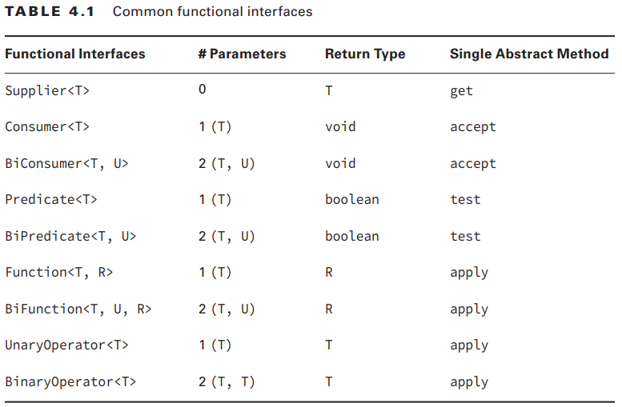
2-Working with Built-In Functional Interfaces
As you remember, a functional interface has exactly one abstract method. All of the functional interfaces in Table 4.1 were introduced in Java 8 and are provided in the java.util.function package. The convention here is to use the generic type T for type parameter. If a second type parameter is needed, the next letter, U, is used. If a distinct return type is needed, R for return is used for the generic type.

Slide 11
2-Working with Built-In Functional Interfaces
Many other functional interfaces are defined in the java.util.function package. They are for working with primitives, which you’ll see later in the chapter.
You do need to memorize this table. We will give you lots of practice in this section to help make this memorable.
Let’s look at how to implement each of these interfaces. Since both lambdas and method references show up all over, we show an implementation using both where possible.

Slide 12
2-Working with Built-In Functional Interfaces
1-Implementing Supplier A Supplier is used when you want to generate or supply values without taking any input. The Supplier interface is defined as @FunctionalInterface public interface Supplier<T> { public T get(); }

Slide 13
2-Working with Built-In Functional Interfaces
1-Implementing Supplier On the OCA, you learned that you could create a date using a factory. If you’ve forgotten how, don’t worry. We will be covering it again in Chapter 5 , “Dates, Strings, and Localization,”. You can use a Supplier to call this factory: Supplier<LocalDate> s1 = LocalDate::now; Supplier<LocalDate> s2 = () -> LocalDate.now(); LocalDate d1 = s1.get(); LocalDate d2 = s2.get(); System.out.println(d1); System.out.println(d2); .

Slide 14
2-Working with Built-In Functional Interfaces
1-Implementing Supplier A Supplier is often used when constructing new objects. For example, we can print two empty StringBuilders: Supplier<StringBuilder> s1 = StringBuilder::new; Supplier<StringBuilder> s2 = () -> new StringBuilder(); System.out.println(s1.get()); System.out.println(s2.get()); .

Slide 15
2-Working with Built-In Functional Interfaces
1-Implementing Supplier Can you figure out what the following does? Just take it one step at a time. Supplier<ArrayList<String>> s1 = ArrayList<String>::new; ArrayList<String> a1 = s1.get(); System.out.println(a1); We have a Supplier of a certain type. That type happens to be ArrayList<String>. Then calling get() creates a new instance of ArrayList<String>, which is the generic type of the Supplier—in other words, a generic that contains another generic.

Slide 16
2-Working with Built-In Functional Interfaces
1-Implementing Supplier Notice how we called get() on the functional interface. What would happen if we tried to print out s1 itself? System.out.println(s1); prints something like this: functionalinterface.BuiltIns$$Lambda$1/791452441@1fb3ebeb That’s the result of calling toString() on a lambda. Yuck. This actually does mean something. Our test class is named BuiltIns, and it is in a package that we created named functionalinterface. Then comes $$, which means that the class doesn’t exist in a class file on the file system. It exists only in memory. You don’t need to worry about the rest.

Slide 17
2-Working with Built-In Functional Interfaces
2-Implementing Consumer and BiConsumer You use a Consumer when you want to do something with a parameter but not return anything. BiConsumer does the same thing except that it takes two parameters. Omitting the default methods, the interfaces are defined as follows: @FunctionalInterface public interface Consumer<T> { void accept(T t); } @FunctionalInterface public interface BiConsumer<T, U> { void accept(T t, U u); }

Slide 18
2-Working with Built-In Functional Interfaces
2-Implementing Consumer and BiConsumer You’ll notice this pattern. Bi means two. It comes from Latin, but you can remember it from English words like binary (0 or 1) or bicycle (two wheels). Always add another parameter when you see Bi show up.
Here’s that example actually being assigned to the Consumer interface: Consumer<String> c1 = System.out::println; Consumer<String> c2 = x -> System.out.println(x); c1.accept("Annie"); c2.accept("Annie"); This example prints Annie twice. You might notice that the Consumer examples used the method reference System.out::println. That’s OK. Java uses the context of the lambda to determine which overloaded println() method it should call.

Slide 19
2-Working with Built-In Functional Interfaces
2-Implementing Consumer and BiConsumer BiConsumer is called with two parameters. They don’t have to be the same type. For example, we can put a key and a value in a map using this interface: Map<String, Integer> map = new HashMap<>(); BiConsumer<String, Integer> b1 = map::put; BiConsumer<String, Integer> b2 = (k, v) -> map.put(k, v); b1.accept("chicken", 7); b2.accept("chick", 1); System.out.println(map); This time we used an instance method reference since we want to call a method on the local variable map, The code to instantiate b1 is a good bit shorter than the code for b2. This is probably why the exam is so fond of method references.

Slide 20
2-Working with Built-In Functional Interfaces
2-Implementing Consumer and BiConsumer As another example, we use the same type for both generic parameters: Map<String, String> map = new HashMap<>(); BiConsumer<String, String> b1 = map::put; BiConsumer<String, String> b2 = (k, v) -> map.put(k, v); b1.accept("chicken", "Cluck"); b2.accept("chick", "Tweep"); System.out.println(map);
The output is {chicken=Cluck, chick=Tweep}, which shows that a BiConsumer can use the same type for both the T and U generic parameters.

Slide 21
2-Working with Built-In Functional Interfaces
3-Implementing Predicate and BiPredicate You’ve been using Predicate since the OCA, and you saw it again more recently with removeIf() in Chapter 3. Predicate is often used when filtering or matching. Both are very common operations. A BiPredicate is just like a Predicate except that it takes two parameters instead of one. Omitting any default or static methods, the interfaces are defined as follows: @FunctionalInterface public interface Predicate<T> { boolean test(T t); } @FunctionalInterface public interface BiPredicate<T, U> { boolean test(T t, U u); }

Slide 22
2-Working with Built-In Functional Interfaces
3-Implementing Predicate and BiPredicate It should be old news by now that you can use a Predicate to test a condition: Predicate<String> p1 = String::isEmpty; Predicate<String> p2 = x -> x.isEmpty(); System.out.println(p1.test("")); System.out.println(p2.test(""));

Slide 23
2-Working with Built-In Functional Interfaces
3-Implementing Predicate and BiPredicate This prints true twice. More interesting is a BiPredicate. This example also prints true twice: BiPredicate<String, String> b1 = String::startsWith; BiPredicate<String, String> b2 = (string, prefix) -> string.startsWith(prefix); System.out.println(b1.test("chicken", "chick")); System.out.println(b2.test("chicken", "chick"));

Slide 24
2-Working with Built-In Functional Interfaces
3-Implementing Predicate and BiPredicate The method reference combines two techniques that you’ve already seen. startsWith() is an instance method. This means that the first parameter in the lambda is used as the instance on which to call the method. The second parameter is passed to the startsWith() method itself. This is another example of how method references save a good bit of typing. The downside is that they are less explicit, and you really have to understand what is going on!

Slide 25
2-Working with Built-In Functional Interfaces
4- Implementing Function and BiFunction A Function is responsible for turning one parameter into a value of a potentially different type and returning it. Similarly, a BiFunction is responsible for turning two parameters into a value and returning it. Omitting any default or static methods, the interfaces are defined as the following: @FunctionalInterface public interface Function<T, R> { R apply(T t);
}

Slide 26
2-Working with Built-In Functional Interfaces
4- Implementing Function and BiFunction @FunctionalInterface public interface BiFunction<T, U, R> { R apply(T t, U u); } For example, this function converts a String to the length of the String: Function<String, Integer> f1 = String::length; Function<String, Integer> f2 = x -> x.length(); System.out.println(f1.apply("cluck")); // 5 System.out.println(f2.apply("cluck")); // 5

Slide 27
2-Working with Built-In Functional Interfaces
4- Implementing Function and BiFunction The following combines two String objects and produces another String: BiFunction<String, String, String> b1 = String::concat; BiFunction<String, String, String> b2 = (string, toAdd) -> string.concat(toAdd); System.out.println(b1.apply("baby ", "chick")); // baby chick System.out.println(b2.apply("baby ", "chick")); // baby chick The first two types in the BiFunction are the input types. The third is the result type. For the method reference, the first parameter is the instance that concat() is called on and the second is passed to concat().

Slide 28
2-Working with Built-In Functional Interfaces
5- Implementing UnaryOperator and BinaryOperator UnaryOperator and BinaryOperator are a special case of a function. They require all type parameters to be the same type. A UnaryOperator transforms its value into one of the same type. For example, incrementing by one is a unary operation. In fact, UnaryOperator extends Function. A BinaryOperator merges two values into one of the same type. Adding two numbers is a binary operation. Similarly, BinaryOperator extends BiFunction. Omitting any default or static methods, the interfaces are defined as follows:

Slide 29
2-Working with Built-In Functional Interfaces
5- Implementing UnaryOperator and BinaryOperator
@FunctionalInterface public interface UnaryOperator<T> extends Function<T, T> { }
@FunctionalInterface public interface BinaryOperator<T>extends BiFunction<T, T, T> { } This means that method signatures look like this: T apply(T t); T apply(T t1, T t2);

Slide 30
2-Working with Built-In Functional Interfaces
5- Implementing UnaryOperator and BinaryOperator
For the unary example, notice how the return type is the same type as the parameter: UnaryOperator<String> u1 = String::toUpperCase; UnaryOperator<String> u2 = x -> x.toUpperCase(); System.out.println(u1.apply("chirp")); System.out.println(u2.apply("chirp")); This prints CHIRP twice. We don’t need to specify the return type in the generics because UnaryOperator requires it to be the same as the parameter.

Slide 31
2-Working with Built-In Functional Interfaces
5- Implementing UnaryOperator and BinaryOperator
And now for the binary example:
BinaryOperator<String> b1 = String::concat; BinaryOperator<String> b2 = (string, toAdd) -> string.concat(toAdd);
System.out.println(b1.apply("baby ", "chick")); // baby chick System.out.println(b2.apply("baby ", "chick")); // baby chick Notice that this does the same thing as the BiFunction example. The code is more succinct, which shows the importance of using the correct functional interface. It’s nice to have one generic type specified instead of three.

Slide 32
2-Working with Built-In Functional Interfaces
Checking Functional Interfaces It’s really important to know the number of parameters, types, return value, and method name for each of the functional interfaces. Now would be a good time to memorize Table 4.1 if you haven’t done so already.
Let’s do some examples to practice.

Slide 33
2-Working with Built-In Functional Interfaces
Checking Functional Interfaces What functional interface would you use in these three situations? ■ Returns a String without taking any parameters ■ Returns a Boolean and takes a String ■ Returns an Integer and takes two Integers
The first one is a Supplier because it generates an object and takes zero parameters. The second one is a Function because it takes one parameter and returns another type. It’s a little tricky. You might think it is a Predicate. Note that a Predicate returns a boolean primitive and not a Boolean object. Finally, the third one is either a BinaryOperator or BiFunction. Since BinaryOperator is a special case of BiFunction, either is a correct answer. BinaryOperator is the better answer of the two since it is more specific.

Slide 34
2-Working with Built-In Functional Interfaces
Again, think about the answers before continuing. Ready? Line 6 passes one String parameter to the lambda and returns a boolean. This tells us that it is a Predicate or Function. Since the generic declaration has only one parameter, it is a Predicate. Line 7 passes one Long parameter to the lambda and doesn’t return anything. This tells us that it is a Consumer. Line 8 takes two parameters and returns a boolean. When you see a boolean returned, think Predicate unless the generics specify a Boolean return type. In this case, there are two parameters, so it is a BiPredicate.
Checking Functional Interfaces Let’s try this exercise again but with code. It’s harder with code. With code, the first thing you do is look at how many parameters the lambda takes and whether there is a return value. What functional interface would you use to fill in the blank for these? 6: _____<List> ex1 = x -> "".equals(x.get(0)); 7: _____<Long> ex2 = (Long l) -> System.out.println(l); 8: _____ <String, String> ex3 = (s1, s2) -> false;

Slide 35
2-Working with Built-In Functional Interfaces
Line 6 claims to be a Function. A Function needs to specify two generics—the input parameter type and the return value type. The return value type is missing from line 6, causing the code not to compile. Line 7 is a UnaryOperator, which returns the same type as it is passed in. The example returns a double rather than a Long, causing the code not to compile. Line 8 is missing the generic for Predicate. This makes the parameter that was passed an Object rather than a String. The lambda expects a String because it calls a method that exists on String rather than Object. Therefore, it doesn’t compile.
Checking Functional Interfaces Now we are going to play “identify the error.” These are meant to be tricky: 6: Function<List<String>> ex1 = x -> x.get(0); // DOES NOT COMPILE 7: UnaryOperator<Long> ex2 = (Long l) -> 3.14; // DOES NOT COMIPLE 8: Predicate ex4 = String::isEmpty; // DOES NOT COMPILE

Slide 36
3-Returning an Optional
Suppose that you are taking an introductory Java class and receive scores of 90 and 100 on the first two exams. Now, we ask you what your average is? An average is calculated by adding the scores and dividing by the number of scores, so you have (90+100)/2. This gives 190/2, so you answer with 95. Great!
Now suppose that you are taking your second class on Java, and it is the first day of class. We ask you what your average is in this class that just started. You haven’t taken any exams yet, so you don’t have anything to average. It wouldn’t be accurate to say that your average is zero. That sounds bad, and it isn’t true. There simply isn’t any data, so you don’t have an average yet.

Slide 37
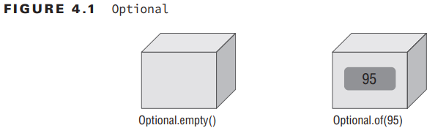
3-Returning an Optional
How do we express this “we don’t know” or “not applicable” answer in Java? Starting with Java 8, we use the Optional type. An Optional is created using a factory. You can either request an empty Optional or pass a value for the Optional to wrap. Think of an Optional as a box that might have something in it or might instead be empty. Figure 4.1 shows both options.

Slide 38
3-Returning an Optional
Here’s how to code our average method: 10: public static Optional<Double> average(int… scores) { 11: if (scores.length == 0) return Optional.empty(); 12: int sum = 0; 13: for (int score: scores) sum += score; 14: return Optional.of((double) sum / scores.length); 15: }

Slide 39
3-Returning an Optional
Here’s how to code our average method: Calling the method shows what is in our two boxes: System.out.println(average(90, 100)); // Optional[95.0] System.out.println(average()); // Optional.empty You can see that one Optional contains a value and the other is empty. Normally, we want to check if a value is there and/or get it out of the box. Here’s one way to do that: 20: Optional<Double> opt = average(90, 100); 21: if (opt.isPresent()) 22: System.out.println(opt.get()); // 95.0

Slide 40
3-Returning an Optional
Line 21 checks whether the Optional actually contains a value. Line 22 prints it out. What if we didn’t do the check and the Optional was empty? 26: Optional<Double> opt = average(); 27: System.out.println(opt.get()); // bad We’d get an exception since there is no value inside the Optional: java.util.NoSuchElementException: No value present

Slide 41
3-Returning an Optional
When creating an Optional, it is common to want to use empty when the value is null. You can do this with an if statement or ternary operator. We use the ternary operator to make sure that you remember how it works from the OCA: Optional o = (value== null) ? Optional.empty(): Optional.of(value); If value is null, o is assigned the empty Optional. Otherwise, we wrap the value. Since this is such a common pattern, Java provides a factory method to do the same thing: Optional o = Optional.ofNullable(value);

Slide 42
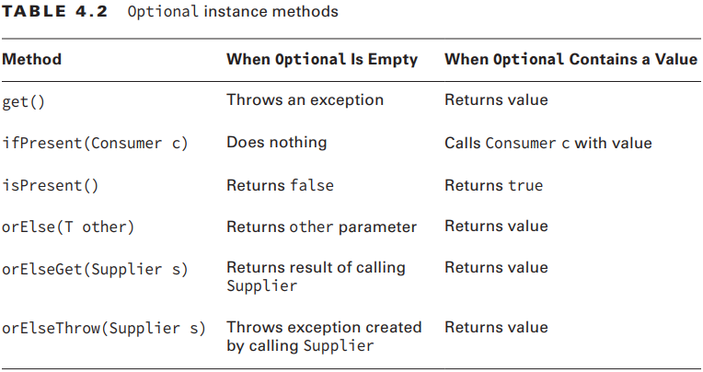
3-Returning an Optional
Table 4.2 summarizes most of the instance methods on Optional that you need to know for the exam. There are a few others that involve chaining.

Slide 43
3-Returning an Optional
You’ve already seen get() and isPresent(). The other methods allow you to write code that uses an Optional in one line without having to use the ternary operator. This makes the code easier to read. Instead of using an if statement, which we used when checking the average earlier, we can specify a Consumer to be run when there is a value inside the Optional. When there isn’t, the method simply skips running the Consumer: Optional<Double> opt = average(90, 100); opt.ifPresent(System.out::println); Using ifPresent() better expresses our intent. We want something done if a value is present.

Slide 44
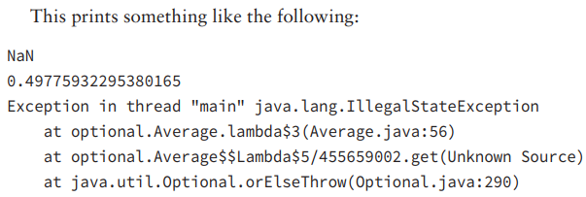
3-Returning an Optional
The other methods allow you to specify what to do if a value isn’t present. There are three choices:
30: Optional<Double> opt = average(); 31: System.out.println(opt.orElse(Double.NaN)); 32: System.out.println(opt.orElseGet(() -> Math.random())); 33: System.out.println(opt.orElseThrow(() -> new IllegalStateException()));

Slide 45
3-Returning an Optional
Notice that the two methods that take a Supplier have different names. Do you see why this code does not compile? System.out.println(opt.orElseGet( () -> new IllegalStateException())); // DOES NOT COMPILE
opt is an Optional<Double>. This means the Supplier must return a Double.
Since this supplier returns an exception, the type does not match.
The last example with Optional is really easy. What do you think this does?

Slide 46
3-Returning an Optional
Optional<Double> opt = average(90, 100); System.out.println(opt.orElse(Double.NaN)); System.out.println(opt.orElseGet(() -> Math.random())); System.out.println(opt.orElseThrow(() -> new IllegalStateException())); It prints out 95 three times. Since the value does exist, there is no need to use the “orelse” logic.

Slide 47
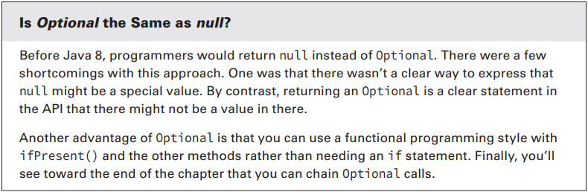
3-Returning an Optional

Slide 48
4-Using Streams
A stream (flux) in Java is a sequence of data. A stream pipeline is the operations that run on a stream to produce a result. Think of a stream pipeline as an assembly line in a factory.

Slide 49
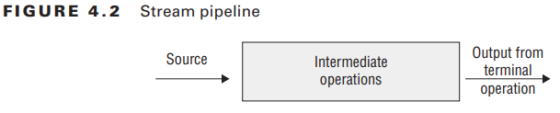
4-Using Streams
There are three parts to a stream pipeline, as shown in Figure 4.2: ■ Source: Where the stream comes from. ■ Intermediate operations: Transforms the stream into another one. There can be as few or as many intermediate operations as you’d like. Since streams use lazy evaluation, the intermediate operations do not run until the terminal operation runs. ■ Terminal operation: Actually produces a result. Since streams can be used only once, the stream is no longer valid after a terminal operation completes.

Slide 50
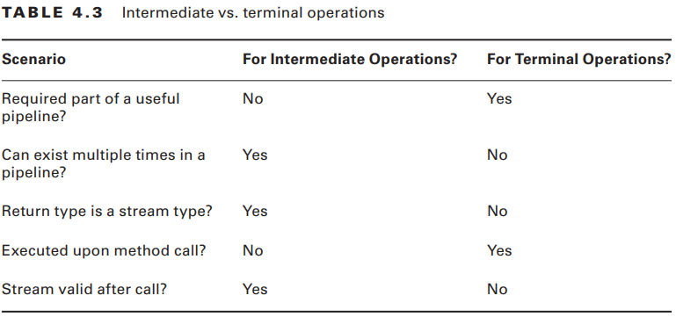
4-Using Streams
In the following sections, we will cover the three parts of the pipeline. We will also discuss special types of streams for primitives and how to print a stream.

Slide 51
4-Using Streams
1-Creating Stream Sources In Java, the Stream interface is in the java.util.stream package. There are a few ways to create a finite stream: 1: Stream<String> empty = Stream.empty(); // count = 0 2: Stream<Integer> singleElement = Stream.of(1); // count = 1 3: Stream<Integer> fromArray = Stream.of(1, 2, 3); // count = 3 Since streams are new in Java 8, most code that’s already written uses lists. Java provides a convenient way to convert from a list to a stream:

Slide 52
4-Using Streams
1-Creating Stream Sources 4: List<String> list = Arrays.asList("a", "b", "c"); 5: Stream<String> fromList = list.stream(); 6: Stream<String> fromListParallel = list.parallelStream(); Line 5 shows that it is a simple method call to create a stream from a list. Line 6 does the same, except that it creates a stream that is allowed to process elements in parallel. This is a great feature because you can write code that uses parallelism before even learning what a thread is. You’ll learn much more about running in parallel in Chapter 7 , “Concurrency.

Slide 53
4-Using Streams
1-Creating Stream Sources 7: Stream<Double> randoms = Stream.generate(Math::random); 8: Stream<Integer> oddNumbers = Stream.iterate(1, n -> n + 2); Line 7 generates a stream of random numbers. How many random numbers? However many you need. If you call randoms.forEach(System.out::println), the program will print random numbers until you kill it. Later in the chapter, you’ll learn about operations like limit() to turn the infinite stream into a finite stream.

Slide 54
4-Using Streams
1-Creating Stream Sources Line 8 gives you more control. iterate() takes a seed or starting value as the first parameter. This is the first element that will be part of the stream. The other parameter is a lambda expression that gets passed the previous value and generates the next value. As with the random numbers example, it will keep on producing odd numbers as long as you need them.
If you try to call System.out.println(stream), you’ll get something like java.util.stream.ReferencePipeline$3@4517d9a3. This is different than a Collection where you see the contents.

Slide 55
4-Using Streams
2-Using Common Terminal Operations
You can perform a terminal operation without any intermediate operations but not the other way around. This is why we will talk about terminal operations first.
Reductions are a special type of terminal operation where all of the contents of the stream are combined into a single primitive or Object. For example, you might have an int or a Collection.

Slide 56
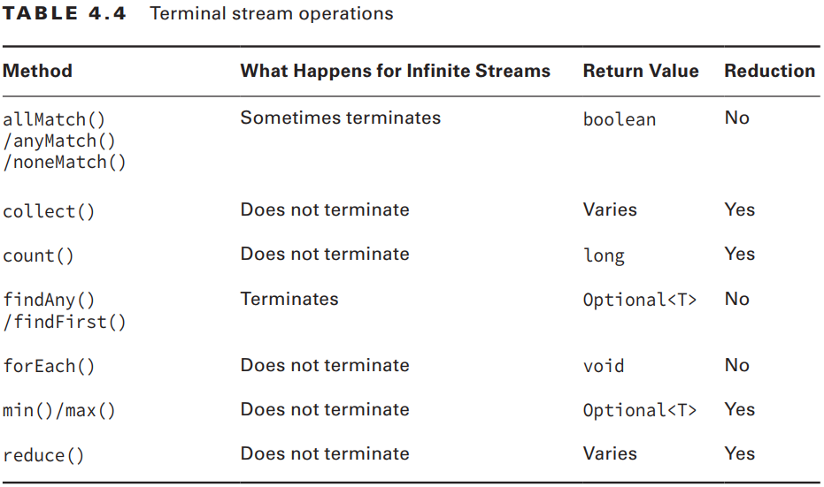
4-Using Streams
2-Using Common Terminal Operations
Table 4.4 summarizes this section. Feel free to use it as a guide to remember the most important points as we go through each one individually. We explain them from easiest to hardest rather than alphabetically.

Slide 57
4-Using Streams
2-Using Common Terminal Operations
2-1- count() The count() method determines the number of elements in a finite stream. For an infinite stream, it hangs. Why? Count from 1 to infinity and let us know when you are finished. Or rather don’t do that because we’d rather you study for the exam than spend the rest of your life counting. count() is a reduction because it looks at each element in the stream and returns a single value.

Slide 58
4-Using Streams
2-Using Common Terminal Operations
2-1- count() The method signature is this: long count() This example shows calling count() on a finite stream: Stream<String> s = Stream.of("monkey", "gorilla", "bonobo"); System.out.println(s.count()); // 3

Slide 59
4-Using Streams
2-Using Common Terminal Operations
2-2- min() and max() The min() and max() methods allow you to pass a custom comparator and find the smallest or largest value in a finite stream according to that sort order. Like count(), min() and max() hang on an infinite stream because they cannot be sure that a smaller or larger value isn’t coming later in the stream. Both methods are reductions because they return a single value after looking at the entire stream.

Slide 60
4-Using Streams
2-Using Common Terminal Operations
2-2- min() and max() The method signatures are as follows: Optional<T> min(<? super T> comparator) Optional<T> max(<? super T> comparator) This example finds the animal with the fewest letters in its name: Stream<String> s = Stream.of("monkey", "ape", "bonobo"); Optional<String> min = s.min((s1, s2) -> s1.length()—s2.length()); min.ifPresent(System.out::println); // ape

Slide 61
4-Using Streams
2-Using Common Terminal Operations
2-3- findAny() and findFirst() The findAny() and findFirst() methods return an element of the stream unless the stream is empty. If the stream is empty, they return an empty Optional. This is the first method you’ve seen that works with an infinite stream,
These methods are terminal operations but not reductions. The reason is that they sometimes return without processing all of the elements. This means that they return a value based on the stream but do not reduce the entire stream into one value.

Slide 62
4-Using Streams
2-Using Common Terminal Operations
2-3- findAny() and findFirst() The method signatures are these:
Optional<T> findAny() Optional<T> findFirst() This example finds an animal: Stream<String> s = Stream.of("monkey", "gorilla", "bonobo"); Stream<String> infinite = Stream.generate(() -> "chimp"); s.findAny().ifPresent(System.out::println); // monkey infinite.findAny().ifPresent(System.out::println); // chimp

Slide 63
4-Using Streams
2-Using Common Terminal Operations
2-4- allMatch(), anyMatch() and noneMatch() The allMatch(), anyMatch() and noneMatch() methods search a stream and return information about how the stream pertains to the predicate. These may or may not terminate for infinite streams. It depends on the data. Like the find methods, they are not reductions because they do not necessarily look at all of the elements.

Slide 64
4-Using Streams
2-Using Common Terminal Operations
2-4- allMatch(), anyMatch() and noneMatch() The method signatures are as follows: boolean anyMatch(Predicate <? super T> predicate) boolean allMatch(Predicate <? super T> predicate) boolean noneMatch(Predicate <? super T> predicate)

Slide 65
4-Using Streams
2-Using Common Terminal Operations
2-4- allMatch(), anyMatch() and noneMatch() This example checks whether animal names begin with letters: List<String> list = Arrays.asList("monkey", "2", "chimp"); Stream<String> infinite = Stream.generate(() -> "chimp"); Predicate<String> pred = x -> Character.isLetter(x.charAt(0)); System.out.println(list.stream().anyMatch(pred)); // true System.out.println(list.stream().allMatch(pred)); // false System.out.println(list.stream().noneMatch(pred)); // false System.out.println(infinite.anyMatch(pred)); // true

Slide 66
4-Using Streams
2-Using Common Terminal Operations
2-5- forEach() The method signature is the following: void forEach(Consumer<? super T> action) Stream<String> s = Stream.of("Monkey", "Gorilla", "Bonobo"); s.forEach(System.out::print); // MonkeyGorillaBonobo

Slide 67
4-Using Streams
2-Using Common Terminal Operations
2-6- reduce() The reduce() method combines a stream into a single object. As you can tell from the name, it is a reduction. The method signatures are these: T reduce(T identity, BinaryOperator<T> accumulator) Optional<T> reduce(BinaryOperator<T> accumulator) <U> U reduce(U identity, BiFunction<U,? super T,U> accumulator, BinaryOperator<U> combiner) ➔ The third method signature is used when we are processing collections in parallel. It allows Java to create intermediate reductions and then combine them at the end

Slide 68
4-Using Streams
2-Using Common Terminal Operations
2-6- reduce() Let’s take them one at a time. The most common way of doing a reduction is to start with an initial value and keep merging it with the next value. Think about how you would concatenate an array of Strings into a single String without functional programming. It might look something like this: String[] array = new String[] { "w", "o", "l", "f" }; String result = ""; for (String s: array) result = result + s; System.out.println(result);

Slide 69
4-Using Streams
2-Using Common Terminal Operations
2-6- reduce() The initial value of an empty String is the identity. The accumulator combines the current result with the current String. With lambdas, we can do the same thing with a stream and reduction: Stream<String> stream = Stream.of("w", "o", "l", "f"); String word = stream.reduce("", (s, c) -> s + c); System.out.println(word); // wolf

Slide 70
4-Using Streams
2-Using Common Terminal Operations
2-6- reduce() We can even rewrite this with a method reference: Stream<String> stream = Stream.of("w", "o", "l", "f"); String word = stream.reduce("", String::concat); System.out.println(word); // wolf

Slide 71
4-Using Streams
2-Using Common Terminal Operations
2-6- reduce() Let’s try another one. Can you write a reduction to multiply all of the Integer objects in a stream? Try it. Our solution is shown here: Stream<Integer> stream = Stream.of(3, 5, 6); System.out.println(stream.reduce(1, (a, b) -> a*b)); We set the identity to 1 and the accumulator to multiplication. In many cases, the identity isn’t really necessary, so Java lets us omit it. When you don’t specify an identity, an Optional is returned because there might not be any data.

Slide 72
4-Using Streams
2-Using Common Terminal Operations
2-6- reduce() There are three choices for what is in the Optional: ■ If the stream is empty, an empty Optional is returned. ■ If the stream has one element, it is returned. ■ If the stream has multiple elements, the accumulator is applied to combine them.

Slide 73
4-Using Streams
2-Using Common Terminal Operations
2-6- reduce() The following illustrates each of these scenarios: BinaryOperator<Integer> op = (a, b) -> a * b; Stream<Integer> empty = Stream.empty(); Stream<Integer> oneElement = Stream.of(3); Stream<Integer> threeElements = Stream.of(3, 5, 6); empty.reduce(op).ifPresent(System.out::print); // no output oneElement.reduce(op).ifPresent(System.out::print); // 3 threeElements.reduce(op).ifPresent(System.out::print); // 90

Slide 74
4-Using Streams
2-Using Common Terminal Operations
2-7- collect() The collect() method is a special type of reduction called a mutable reduction. It is more efficient than a regular reduction because we use the same mutable object while accumulating. Common mutable objects include StringBuilder and ArrayList.
This is a really useful method, because it lets us get data out of streams and into another form. The method signatures are as follows: <R> R collect(Supplier<R> supplier, BiConsumer<R, ? super T> accumulator, BiConsumer<R, R> combiner) <R,A> R collect(Collector<? super T, A,R> collector)

Slide 75
4-Using Streams
The first parameter is a Supplier that creates the object that will store the results as we collect data. Remember that a Supplier doesn’t take any parameters and returns a value. In this case, it constructs a new StringBuilder. The second parameter is a BiConsumer, which takes two parameters and doesn’t return anything. It is responsible for adding one more element to the data collection. In this example, it appends the next String to the StringBuilder. The final parameter is another BiConsumer. It is responsible for taking two data collections and merging them. This is useful when we are processing in parallel. Two smaller collections are formed and then merged into one.
2-Using Common Terminal Operations
2-7- collect() Our wolf example from reduce can be converted to use collect(): Stream<String> stream = Stream.of("w", "o", "l", "f"); StringBuilder word = stream.collect(StringBuilder::new, StringBuilder::append, StringBuilder:append)

Slide 76
4-Using Streams
In practice, there are many common collectors that come up over and over. Rather than making developers keep reimplementing the same ones, Java provides an interface with common collectors.
2-Using Common Terminal Operations
2-7- collect() Our wolf example from reduce can be converted to use collect(): Stream<String> stream = Stream.of("w", "o", "l", "f"); StringBuilder word = stream.collect(StringBuilder::new, StringBuilder::append, StringBuilder:append)

Slide 77
4-Using Streams
You might get different output for this last one since toSeta HashSet, but you shouldn’t expect or rely on that. () makes no guarantees as to which implementation of Set you’ll get. It is likely to be
2-Using Common Terminal Operations
2-7- collect() Stream<String> stream = Stream.of("w", "o", "l", "f"); TreeSet<String> set = stream.collect(Collectors.toCollection(TreeSet::new)); System.out.println(set); // [f, l, o, w] If we didn’t need the set to be sorted, we could make the code even shorter: Stream<String> stream = Stream.of("w", "o", "l", "f"); Set<String> set = stream.collect(Collectors.toSet()); System.out.println(set); // [f, w, l, o] //
// collect(Collectors.toList());

Slide 78
4-Using Streams
3-Using Common Intermediate Operations Unlike a terminal operation, intermediate operations deal with infinite streams simply by returning an infinite stream. 3-1 filter() The filter() method returns a Stream with elements that match a given expression. Here is the method signature: Stream<T> filter(Predicate<? super T> predicate) This operation is easy to remember and very powerful because we can pass any Predicate to it. For example, this filters all elements that begin with the letter m: Stream<String> s = Stream.of("monkey", "gorilla", "bonobo"); s.filter(x -> x.startsWith("m")).forEach(System.out::print); // monkey

Slide 79
4-Using Streams
3-Using Common Intermediate Operations 3-2- distinct() The distinct() method returns a stream with duplicate values removed. The duplicates do not need to be adjacent to be removed. As you might imagine, Java calls equals() to determine whether the objects are the same. The method signature is as follows: Stream<T> distinct() Here’s an example: Stream<String> s = Stream.of("duck", "duck", "duck", "goose"); s.distinct().forEach(System.out::print); // duck goose

Slide 80
4-Using Streams
3-Using Common Intermediate Operations 3-3- limit() and skip() The limit() and skip() methods make a Stream smaller. They could make a finite stream smaller, or they could make a finite stream out of an infinite stream. The method signatures are shown here: Stream<T> limit(int maxSize) Stream<T> skip(int n) The following code creates an infinite stream of numbers counting from 1. The skip() operation returns an infinite stream starting with the numbers counting from 6, since it skips the first five elements. The limit() call takes the first two of those. Now we have a finite stream with two elements: Stream<Integer> s = Stream.iterate(1, n -> n + 1); s.skip(5).limit(2).forEach(System.out::print); // 6 7

Slide 81
4-Using Streams
3-Using Common Intermediate Operations 3-4- map() The map() method creates a one-to-one mapping from the elements in the stream to the elements of the next step in the stream. The method signature is as follows: <R> Stream<R> map(Function<? super T, ? extends R> mapper) .It uses the lambda expression to figure out the type passed to that function and the one returned. The return type is the stream that gets returned. The map() method on streams is for transforming data. Don’t confuse it with the Map interface, which maps keys to values.

Slide 82
4-Using Streams
3-Using Common Intermediate Operations 3-4- map() As an example, this code converts a list of String objects to a list of Integers representing their lengths: Stream<String> s = Stream.of("monkey", "gorilla", "bonobo"); s.map(String::length).forEach(System.out::print); // 676 Remember that String::length is shorthand for the lambda x -> x.length(), which clearly shows it is a function that turns a String into an Integer.

Slide 83
4-Using Streams
3-Using Common Intermediate Operations 3-5- flatMap() The flatMap() method takes each element in the stream and makes any elements it contains top-level elements in a single stream. This is helpful when you want to remove empty elements from a stream or you want to combine a stream of lists. <R> Stream<R> flatMap(Function<? super T, ? extends Stream<? extends R>> mapper) Don’t worry about the signature. It’s a headache.

Slide 84
4-Using Streams
3-Using Common Intermediate Operations 3-5- flatMap() List<String> zero = Arrays.asList(); List<String> one = Arrays.asList("Bonobo"); List<String> two = Arrays.asList("Mama Gorilla", "Baby Gorilla"); Stream<List<String>> animals = Stream.of(zero, one, two); animals.flatMap(l -> l.stream()).forEach(System.out::println); Here’s the output: Bonobo Mama Gorilla Baby Gorilla As you can see, it removed the empty list completely and changed all elements of each list to be at the top level of the stream.

Slide 85
4-Using Streams
3-Using Common Intermediate Operations 3-6- sorted() The sorted() method returns a stream with the elements sorted. Just like sorting arrays, Java uses natural ordering unless we specify a comparator. The method signatures are these: Stream<T> sorted() Stream<T> sorted(Comparator<? super T> comparator) Calling the first signature uses the default sort order: Stream<String> s = Stream.of("brown-", "bear-"); s.sorted().forEach(System.out::print); // bear-brown

Slide 86
4-Using Streams
It is a reference to a function that takes zero parameters and returns a Comparator. This is not compatible with the interface. This means that we have to use a method and not a method reference.
3-Using Common Intermediate Operations 3-6- sorted() Stream<String> s = Stream.of("brown bear-", "grizzly-"); s.sorted(Comparator.reverseOrder()) .forEach(System.out::print); // grizzly-brown bear
Here we passed a Comparator to specify that we want to sort in the reverse of natural sort order. Ready for a tricky one?
Do you see why this doesn’t compile? s.sorted(Comparator::reverseOrder); // DOES NOT COMPILE

Slide 87
4-Using Streams
3-Using Common Intermediate Operations 3-7- peek() The peek() method is our final intermediate operation. It is useful for debugging because it allows us to perform a stream operation without actually changing the stream. The method signature is as follows: Stream<T> peek(Consumer<? super T> action) The most common use for peek() is to output the contents of the stream as it goes by.

Slide 88
4-Using Streams
When working with a Queue, peek()looks only at the first element. bIn a stream, peek() looks at each element that goes through that part of the stream pipeline. It’s like having a worker take notes on how a particular step of the process is doing.
3-Using Common Intermediate Operations 3-7- peek() Suppose that we made a typo and counted bears beginning with the letter g instead of b. We are puzzled why the count is 1 instead of 2. We can add a peek() to find out why:
Stream<String> stream = Stream.of("black bear", "brown bear", "grizzly"); long count = stream.filter(s -> s.startsWith("g")) .peek(System.out::println).count(); // grizzly System.out.println(count); // 1

Slide 89
4-Using Streams
In Java 7, we’d have to write something like the following: List<String> list = Arrays.asList("Toby", "Anna", "Leroy", "Alex"); List<String> filtered = new ArrayList<>(); for (String name: list) { if (name.length() == 4) filtered.add(name); } Collections.sort(filtered); Iterator<String> iter = filtered.iterator();
if (iter.hasNext()) System.out.println(iter.next()); if (iter.hasNext()) System.out.println(iter.next());
4-Putting Together the Pipeline Streams allow you to use chaining and express what you want to accomplish rather than how to do so. Let’s say that we wanted to get the first two names alphabetically that are four characters long.
In Java 8, the equivalent code is as follows: List<String> list = Arrays.asList("Toby", "Anna", "Leroy", "Alex"); list.stream().filter(n -> n.length() == 4).sorted() .limit(2).forEach(System.out::println);

Slide 90
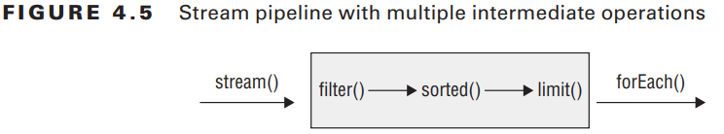
4-Using Streams
4-Putting Together the Pipeline Figure 4.5 shows how each intermediate operation in the pipeline feeds into the next.

Slide 91
4-Using Streams
4-Putting Together the Pipeline What do you think the following does? Stream.generate(() -> "Elsa") .filter(n -> n.length() == 4) .sorted() .limit(2) .forEach(System.out::println);
Stream.generate(() -> "Elsa") .filter(n -> n.length() == 4) .limit(2) .sorted() .forEach(System.out::println);
It actually hangs until you kill the program or it throws an exception after running out of memory.
This one prints Elsa twice.

Slide 92
4-Using Streams
4-Putting Together the Pipeline Finally, what do you think this does? Stream.generate(() -> "Olaf Lazisson") .filter(n -> n.length() == 4) .limit(2) .sorted() .forEach(System.out::println);
This one hangs as well until we kill the program. The filter doesn’t allow anything through, so limit() never sees two elements. This means that we have to keep waiting and hope that they show up.

Slide 93
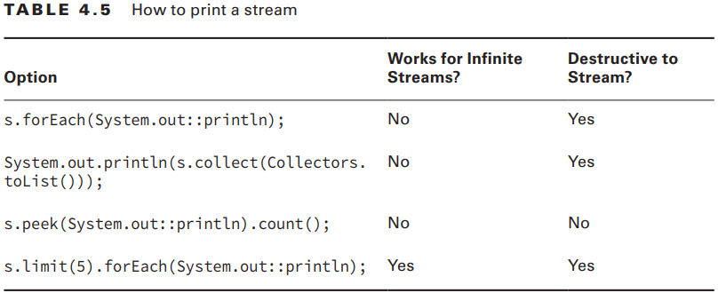
4-Using Streams
5-Printing a Stream Table 4.5 shows some options for printing out the contents of a stream.

Slide 94
5-Working with Primitives
Up until now, we have been using wrapper classes when we needed primitives to go into streams. We did this with the Collections API so it would feel natural. With streams, there are also equivalents that work with the int, double, and long primitives. Let’s take a look at why this is needed. Suppose that we want to calculate the sum of numbers in a finite stream: Stream<Integer> stream = Stream.of(1, 2, 3); System.out.println(stream.reduce(0, (s, n) -> s + n)); Not bad.

Slide 95
5-Working with Primitives
There is another way of doing that: Stream<Integer> stream = Stream.of(1, 2, 3); System.out.println(stream.mapToInt(x -> x).sum());
This time, we converted our Stream<Integer> to an IntStream and asked the IntStream to calculate the sum for us. The primitive streams know how to perform certain common operations automatically.

Slide 96
5-Working with Primitives
IntStream intStream = IntStream.of(1, 2, 3); OptionalDouble avg = intStream.average(); System.out.println(avg.getAsDouble()); Not only is it possible to calculate the average, but it is also easy to do so. Clearly primitive streams are important. We will look at creating and using such streams, including optionals and functional interfaces.

Slide 97
5-Working with Primitives
5-1 Creating Primitive Streams Here are three types of primitive streams: ■ IntStream: Used for the primitive types int, short, byte, and char ■ LongStream: Used for the primitive type long ■ DoubleStream: Used for the primitive types double and float

Slide 98
5-Working with Primitives
5-1 Creating Primitive Streams You can create an empty stream with this: DoubleStream empty = DoubleStream.empty(); Another way is to use the of() factory method from a single value or by using the varargs overload: DoubleStream oneValue = DoubleStream.of(3.14); DoubleStream varargs = DoubleStream.of(1.0, 1.1, 1.2); oneValue.forEach(System.out::println); System.out.println(); varargs.forEach(System.out::println); This code outputs the following: 3.14 1.0 1.1 1.2

Slide 99
5-Working with Primitives
5-1 Creating Primitive Streams You can also use the two methods for creating infinite streams, just like we did with Stream: DoubleStream random = DoubleStream.generate(Math::random); DoubleStream fractions = DoubleStream.iterate(.5, d -> d / 2); random.limit(3).forEach(System.out::println); System.out.println(); fractions.limit(3).forEach(System.out::println);

Slide 100
5-Working with Primitives
5-1 Creating Primitive Streams When dealing with int or long primitives, it is common to count. Suppose that we wanted a stream with the numbers from 1 through 5. We could write this using what we’ve explained so far: IntStream count = IntStream.iterate(1, n -> n+1).limit(5); count.forEach(System.out::println); Java provides a method that can generate a range of numbers: IntStream range = IntStream.range(1, 6); range.forEach(System.out::println);

Slide 101
5-Working with Primitives
5-1 Creating Primitive Streams This is better. The range() method indicates that we want the numbers 1–6, not including the number 6. However, it still could be clearer. We want the numbers 1–5. We should be able to type the number 5, and we can do so as follows: IntStream rangeClosed = IntStream.rangeClosed(1, 5); rangeClosed.forEach(System.out::println);

Slide 102
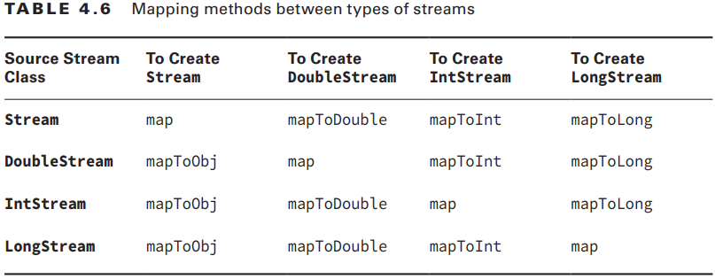
5-Working with Primitives
5-1 Creating Primitive Streams The final way to create a primitive stream is by mapping from another stream type. Table 4.6 shows that there is a method for mapping between any stream types.;

Slide 103
5-Working with Primitives
5-1 Creating Primitive Streams Obviously, they have to be compatible types for this to work. Java requires a mapping function to be provided as a parameter, for example: Stream<String> objStream = Stream.of("penguin", "fish"); IntStream intStream = objStream.mapToInt(s -> s.length()) This function that takes an Object, which is a String in this case. The function returns an int. The function mappings are intuitive here. They take the source type and return the target type. In this example, the actual function type is ToIntFunction.

Slide 104
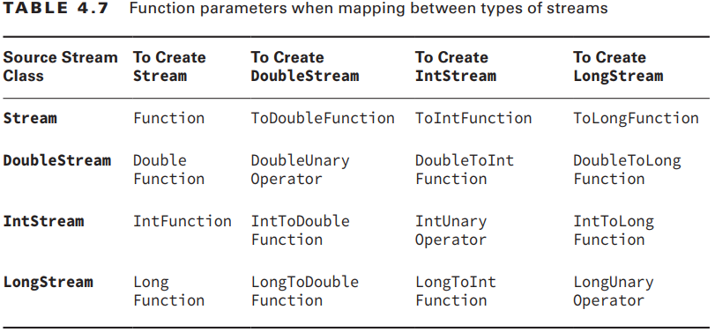
5-Working with Primitives
5-1 Creating Primitive Streams

Slide 105
5-Working with Primitives
5-2 Using Optional with Primitive Streams
Earlier in the chapter, we wrote a method to calculate the average of an int[] and promised a better way later. Now that you know about primitive streams, you can calculate the average in one line:
IntStream stream = IntStream.rangeClosed(1,10); OptionalDouble optional = stream.average(); optional.ifPresent(System.out::println); System.out.println(optional.getAsDouble()); System.out.println(optional.orElseGet(() -> Double.NaN));

Slide 106
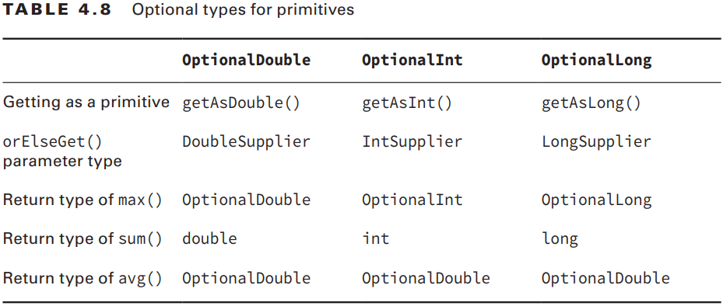
5-Working with Primitives
5-2 Using Optional with Primitive Streams

Slide 107
5-Working with Primitives
5-2 Using Optional with Primitive Streams
Let’s try an example to make sure that you understand this: 5: LongStream longs = LongStream.of(5, 10); 6: long sum = longs.sum(); 7: System.out.println(sum); // 15 8: DoubleStream doubles = DoubleStream.generate(() -> Math.PI); 9: OptionalDouble min = doubles.min(); // runs infinitely

Slide 108
5-Working with Primitives
5-3 Summarizing Statistics You’ve learned enough to be able to get the maximum value from a stream of int primitives. If the stream is empty, we want to throw an exception: private static int max(IntStream ints) { OptionalInt optional = ints.max(); return optional.orElseThrow(RuntimeException::new); } This should be old hat by now. We got an OptionalInt because we have an IntStream. If the optional contains a value, we return it. Otherwise, we throw a newRuntimeException

Slide 109
5-Working with Primitives
5-3 Summarizing Statistics You’ve learned enough to be able to get the maximum value from a stream of int primitives. If the stream is empty, we want to throw an exception: private static int max(IntStream ints) { OptionalInt optional = ints.max(); return optional.orElseThrow(RuntimeException::new); } This should be old hat by now. We got an OptionalInt because we have an IntStream. If the optional contains a value, we return it. Otherwise, we throw a new RuntimeException.

Slide 110
5-Working with Primitives
5-3 Summarizing Statistics Now we want to change the method to take an IntStream and return a range. The range is the minimum value subtracted from the maximum value. Uh-oh. Both min() and max() are terminal operations, which means that they use up the stream when they are run.
We can’t run two terminal operations against the same stream!!!

Slide 111
5-Working with Primitives
5-3 Summarizing Statistics Luckily, this is a common problem and the primitive streams solve it for us with summary statistics. Statistic is just a big word for a number that was calculated from data. private static int range(IntStream ints) { IntSummaryStatistics stats = ints.summaryStatistics(); if (stats.getCount() == 0) throw new RuntimeException(); return stats.getMax()—stats.getMin(); } Here we asked Java to perform many calculations about the stream. This includes the minimum, maximum, average, size, and the number of values in the stream. If the stream were empty, we’d have a count of zero. Otherwise, we can get the minimum and maximum out of the summary.

Slide 112
5-Working with Primitives
5-3 Learning the Functional Interfaces for Primitives Just as there are special streams and optional classes for primitives, there are also special functional interfaces. Luckily, most of them are for the double, int, and long types that you saw for streams and optionals. There is one exception, which is BooleanSupplier. We will cover that before introducing the ones for double, int, and long.

Slide 113
5-Working with Primitives
5-3-1 Functional Interfaces for boolean BooleanSupplier is a separate type. It has one method to implement: boolean getAsBoolean() It works just as you’ve come to expect from functional interfaces, for example: 12: BooleanSupplier b1 = () -> true; 13: BooleanSupplier b2 = () -> Math.random() > .5; 14: System.out.println(b1.getAsBoolean()); 15: System.out.println(b2.getAsBoolean()); Lines 12 and 13 each create a BooleanSupplier, which is the only functional interface for boolean. Line 14 prints true, since it is the result of b1. Line 15 prints out true or false, depending on the random value generated.

Slide 114
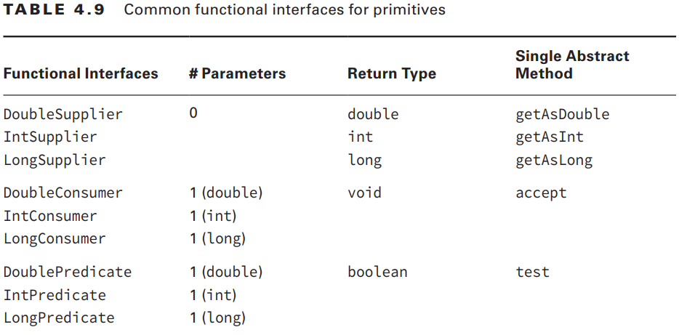
5-Working with Primitives
5-3-2 Functional Interfaces for double, int, and long Most of the functional interfaces are for double, int, and long to match the streams and optionals that we’ve been using for primitives. Table 4.9 shows the equivalent of Table 4.1 for these primitives.

Slide 115
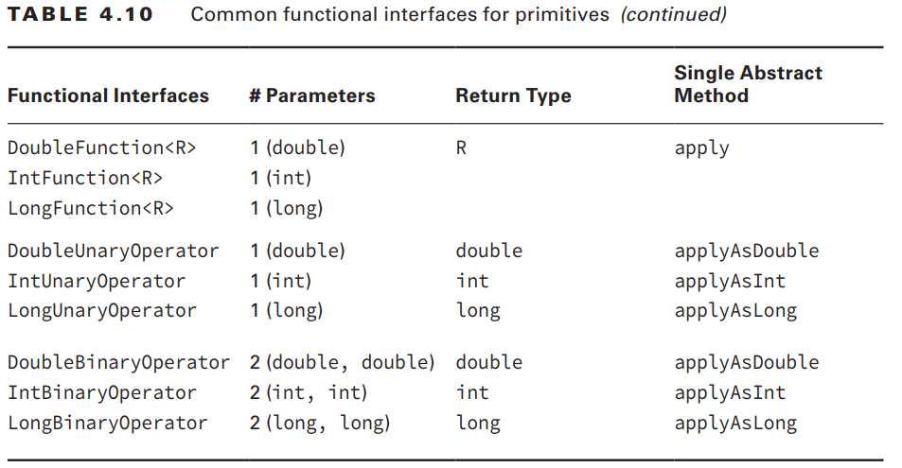
5-Working with Primitives
5-3-2 Functional Interfaces for double, int, and long Most of the functional interfaces are for double, int, and long to match the streams and optionals that we’ve been using for primitives. Table 4.9 shows the equivalent of Table 4.1 for these primitives.

Slide 116
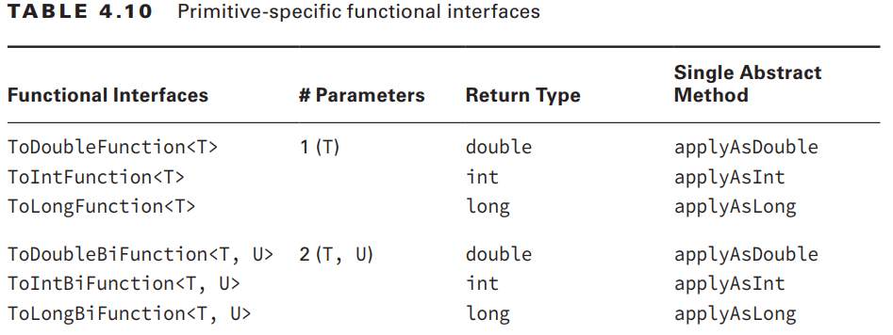
5-Working with Primitives
5-3-2 Functional Interfaces for double, int, and long

Slide 117
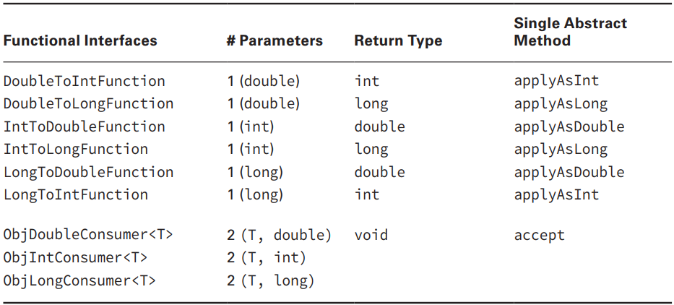
5-Working with Primitives
5-3-2 Functional Interfaces for double, int, and long

Slide 118
5-Working with Primitives
5-3-2 Functional Interfaces for double, int, and long Which functional interface would you use to fill in the blank to make the following code compile? double d = 1.0; _________ f1 = x -> 1; f1.applyAsInt(d);
You can see that the functional interface in question takes a double parameter and returns an int. You can also see that it has a single abstract method named applyAsInt. The only functional interface meeting all three of those criteria is DoubleToIntFunction.

